Slide 1
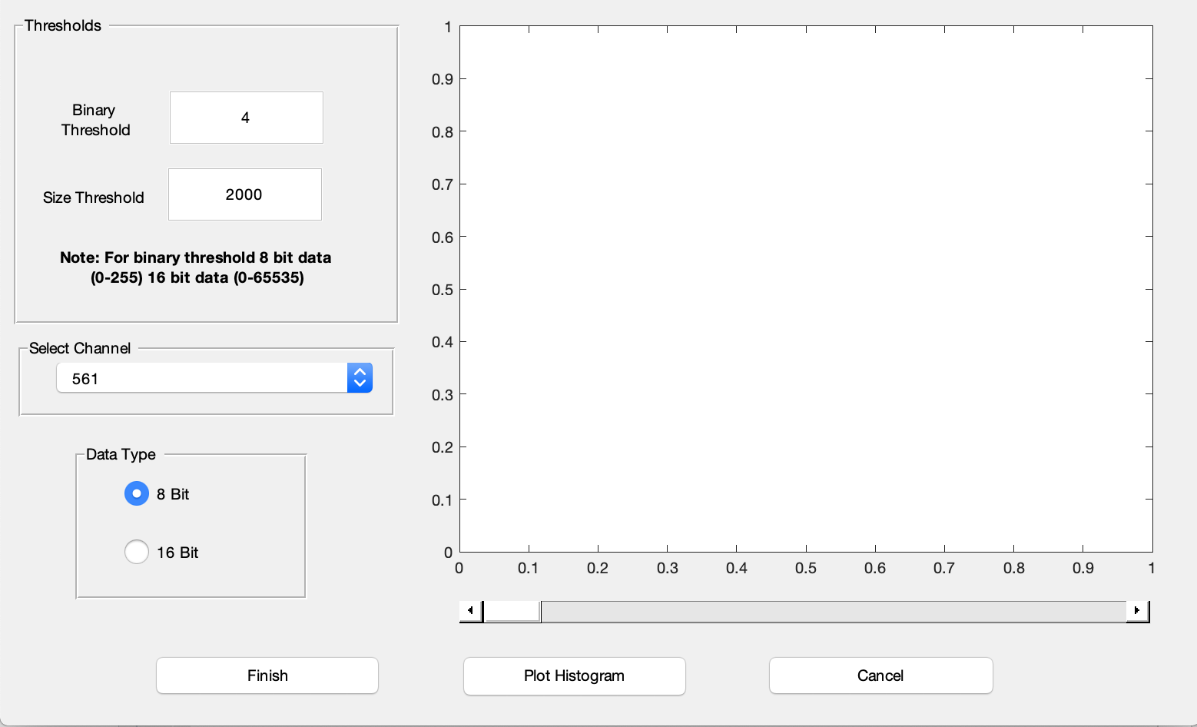
Binary Threshold
Pixels with intensity lower than the binary threshold are removed.
Size Threshold
Pixels with areas greater than the size threshold are removed.
Plot Histogram
Plots a histogram of all pixel values to aid user in setting the binary threshold.

Slide 2
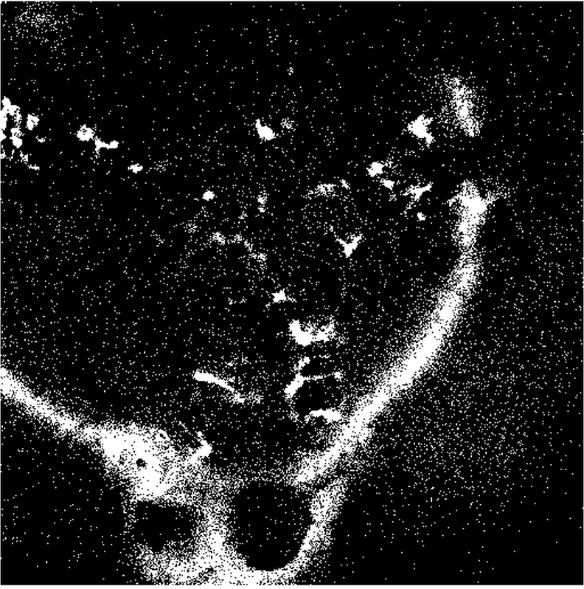
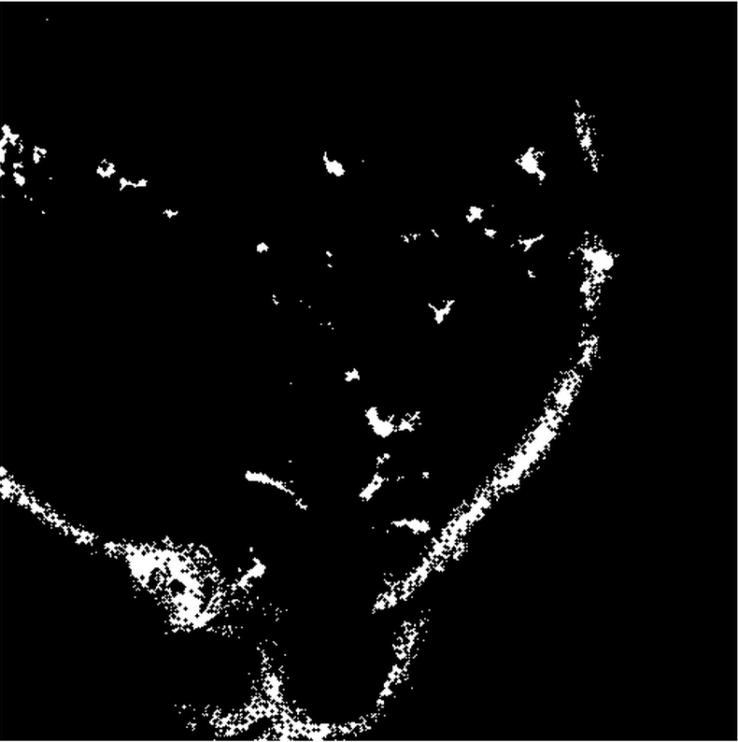
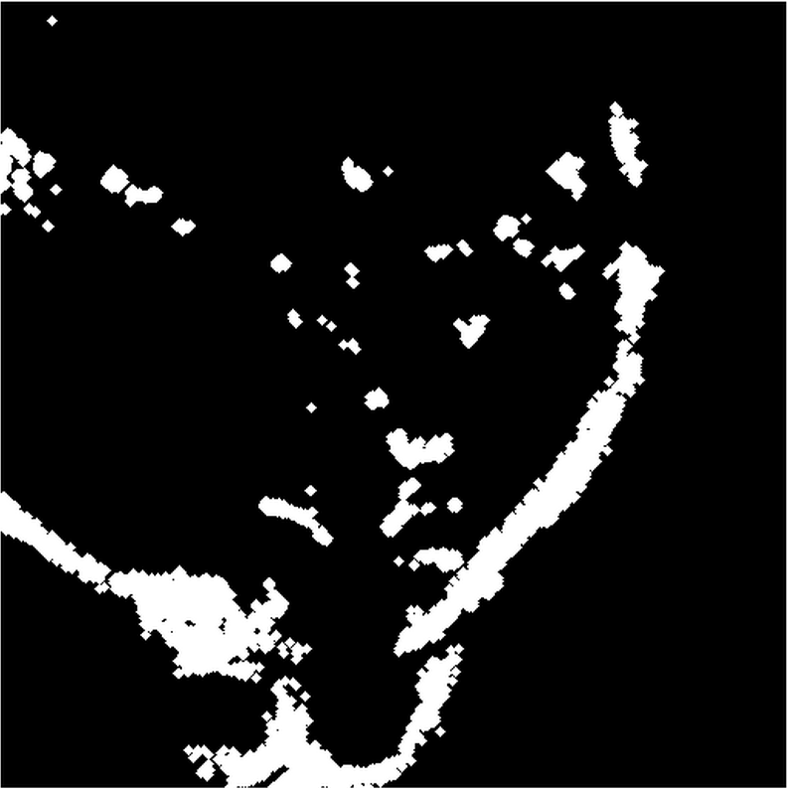
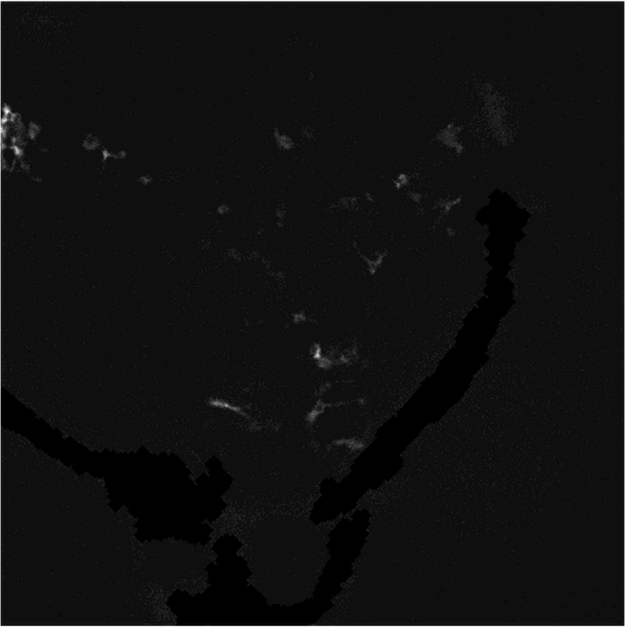
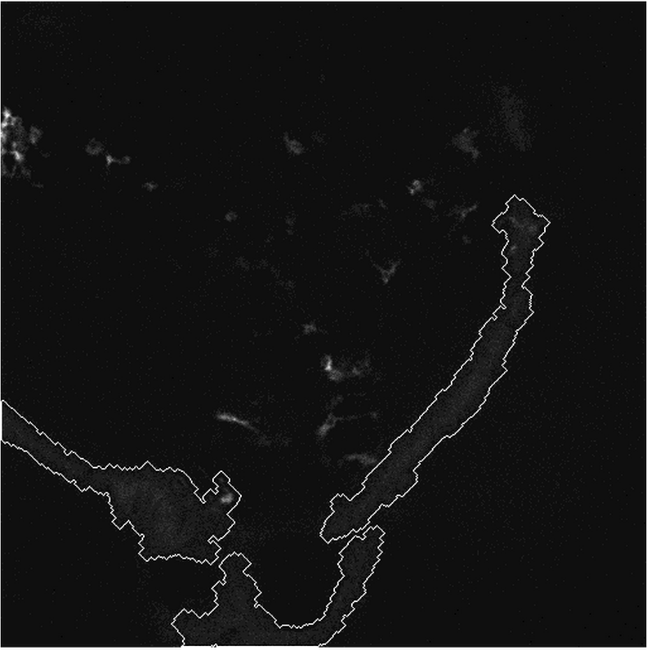
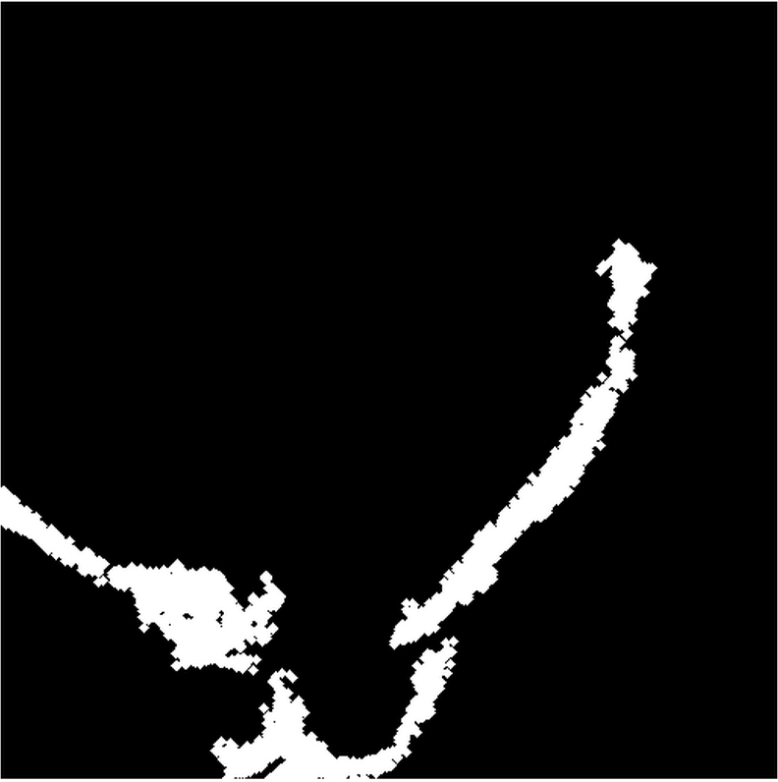
XTSkinZap function processes
Binerize (Binary Threshold)
Erode
Dilate
Data Removal
Data Identification
Size Filter (Size Threshold)

Slide 3
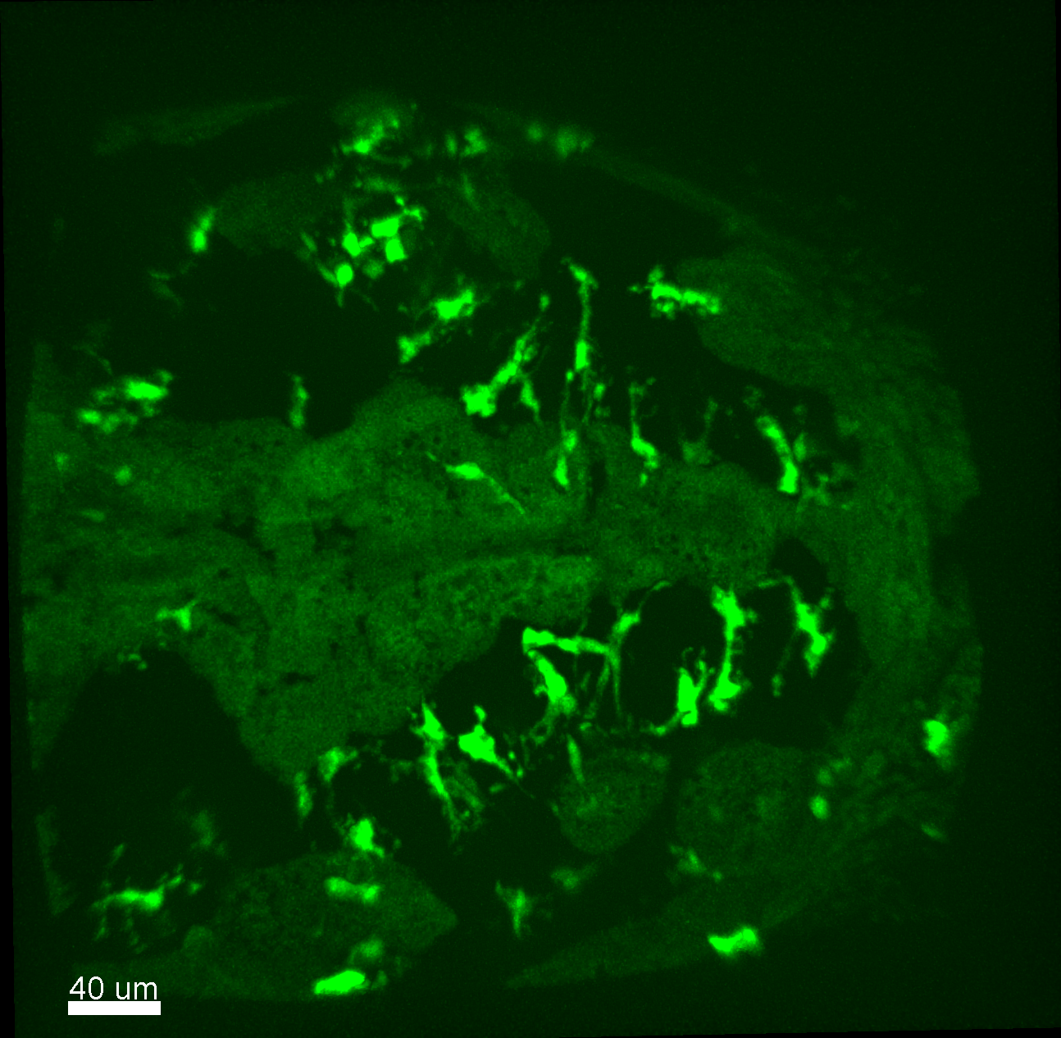
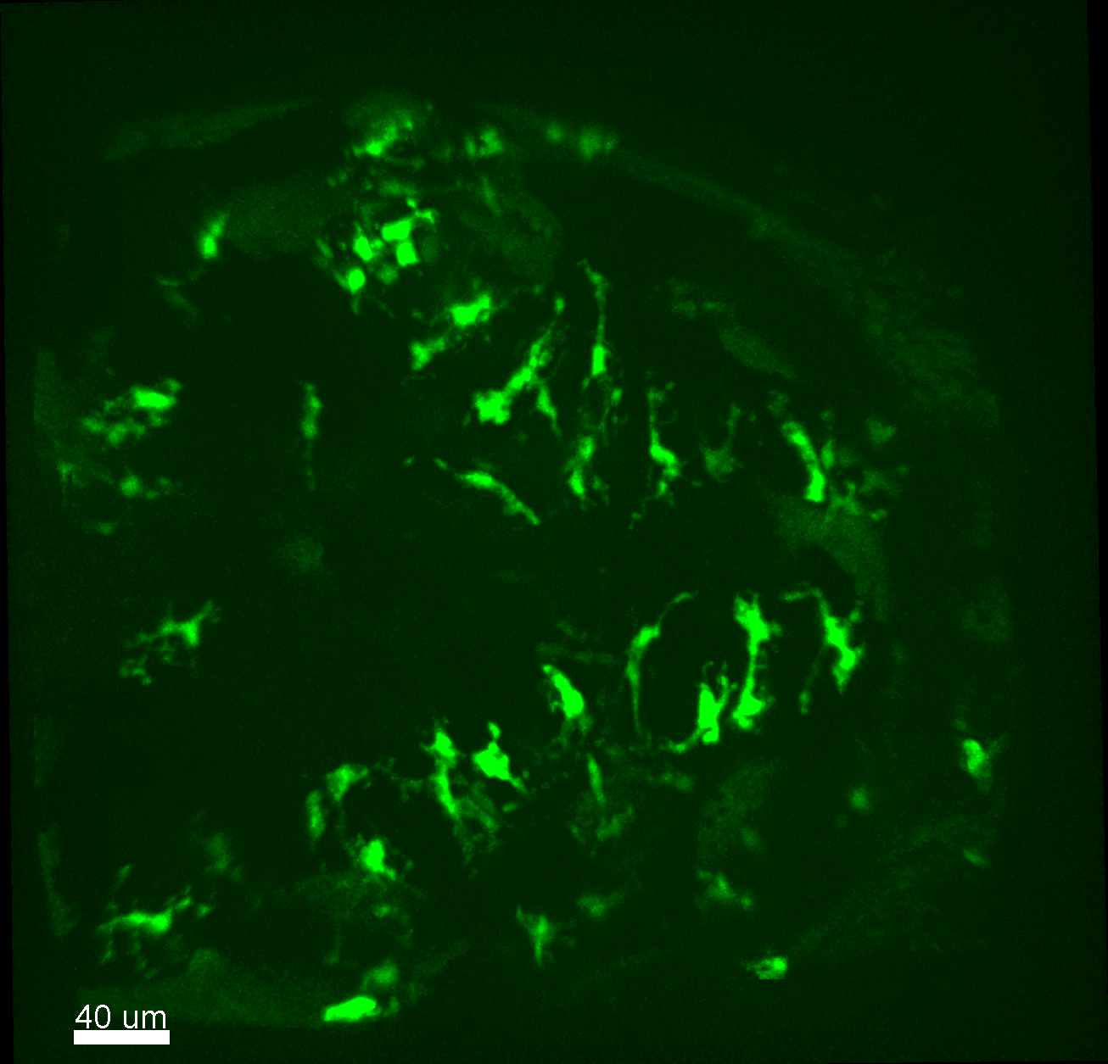
Binary Threshold = 290
Size Threshold = 2000
Before
After
High skin auto fluorescence inhibit clear visualization of GFP signal
SkinZap removes auto fluorescent skin to reveal clearer image.

Slide 4
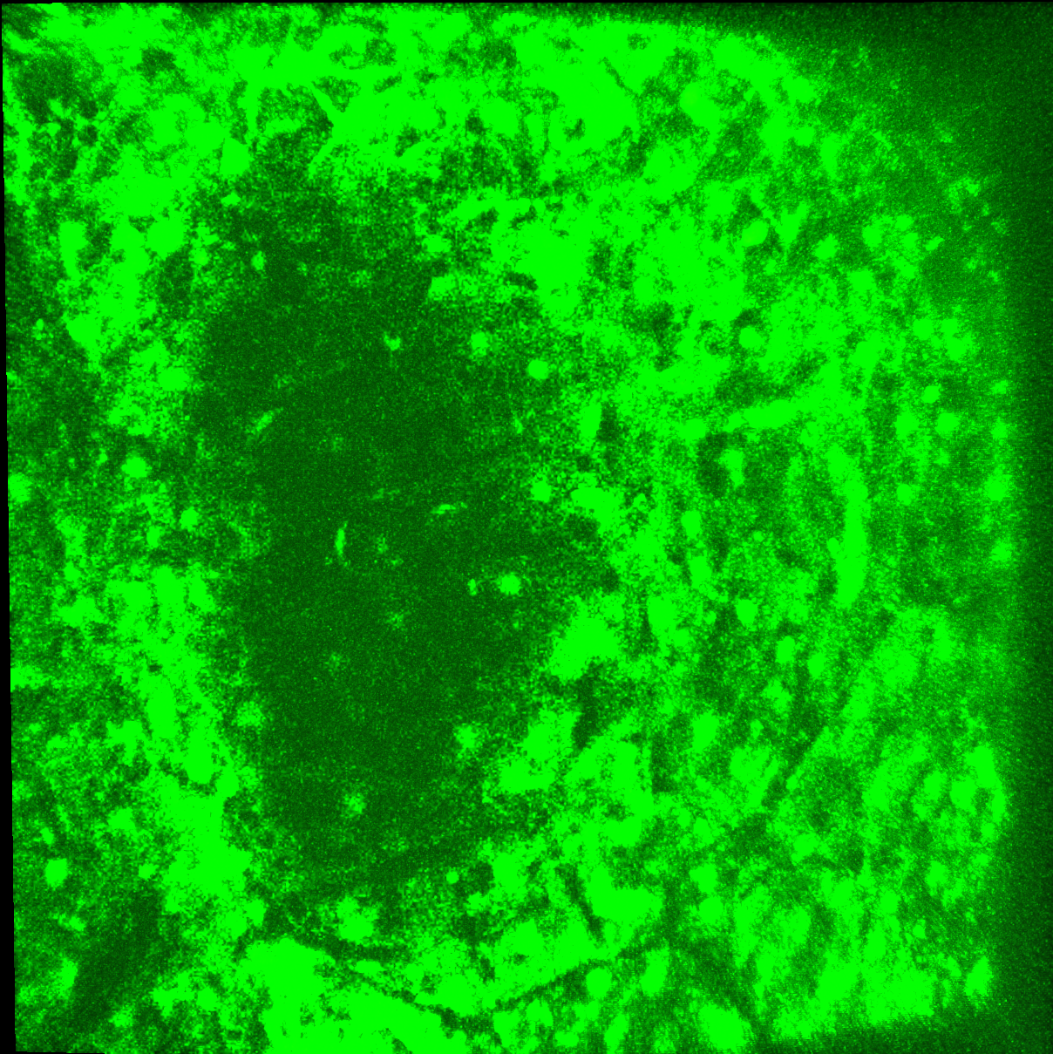
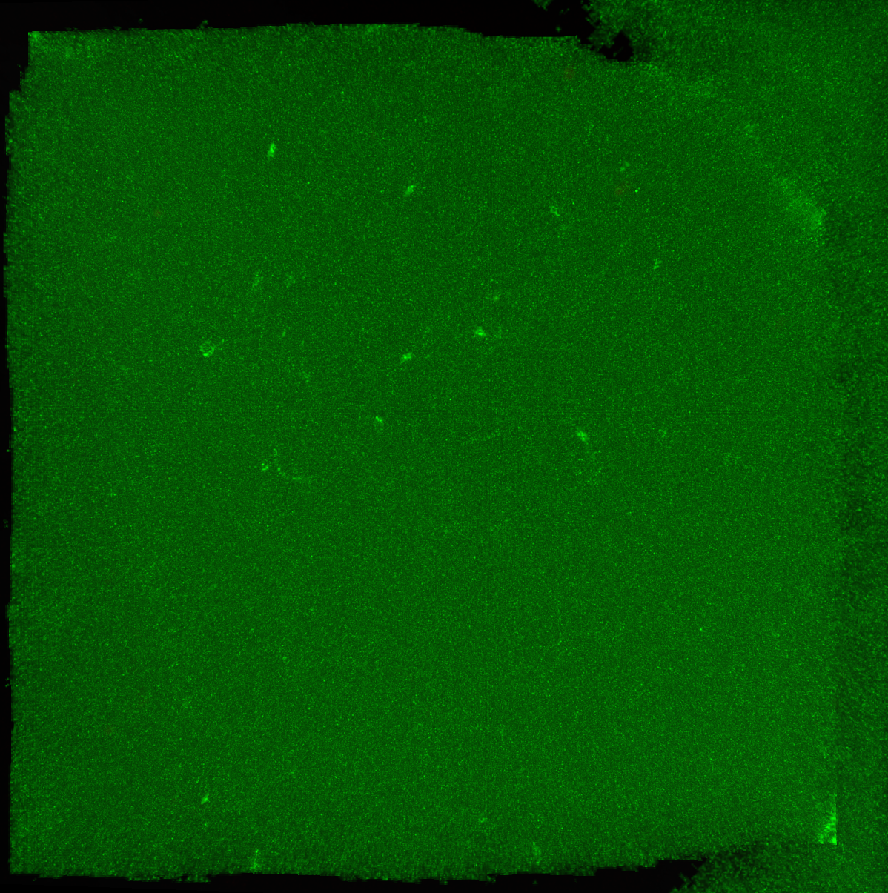
Binary Threshold = 4
Size Threshold = 2000
Before
After
High skin auto fluorescence inhibit visualization of GFP signal
SkinZap removes auto fluorescent skin revealing subsurface signals not visible before (White Triangles)

Slide 5
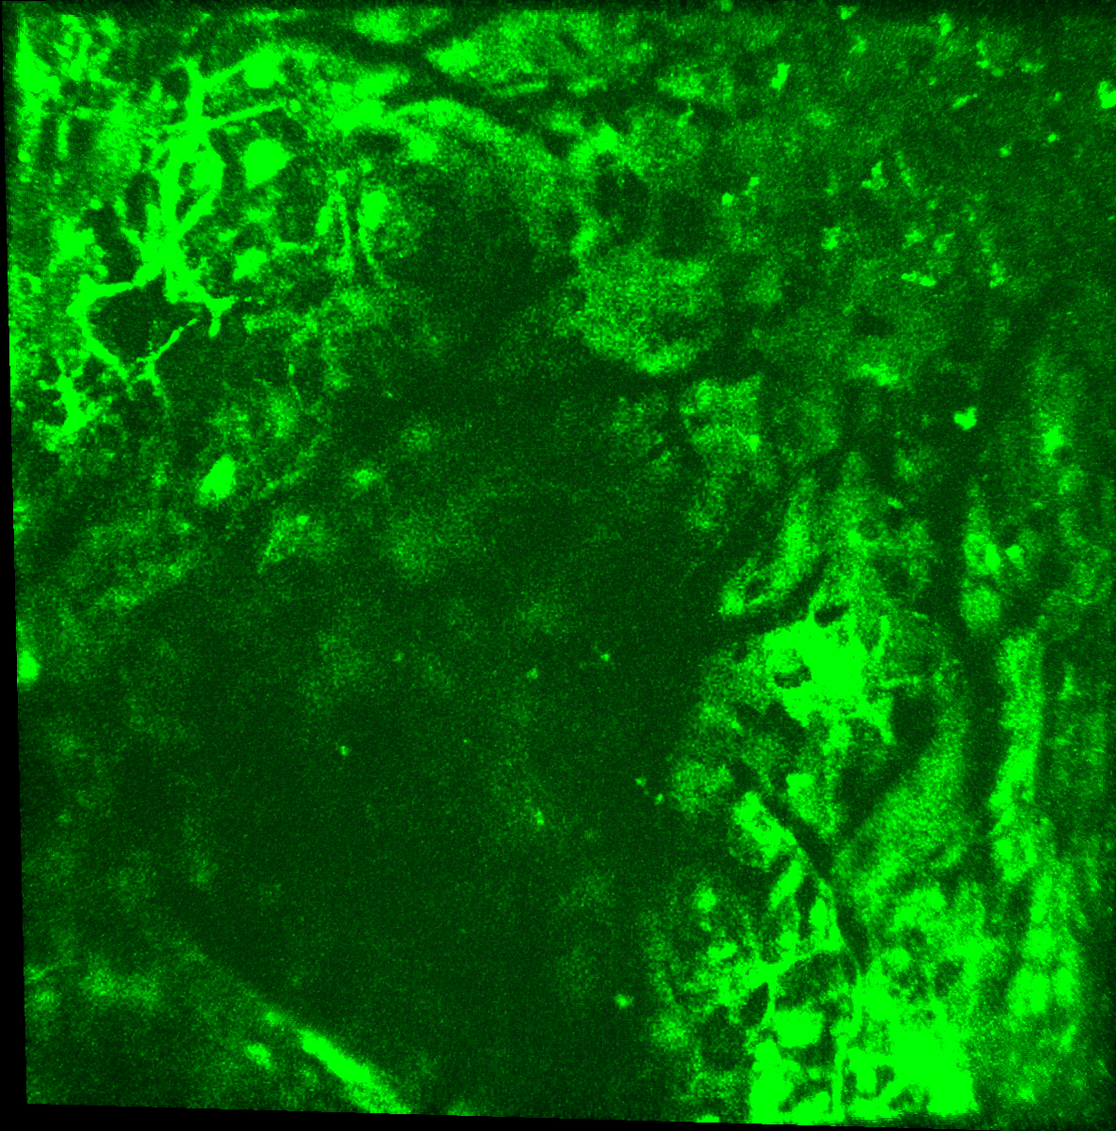
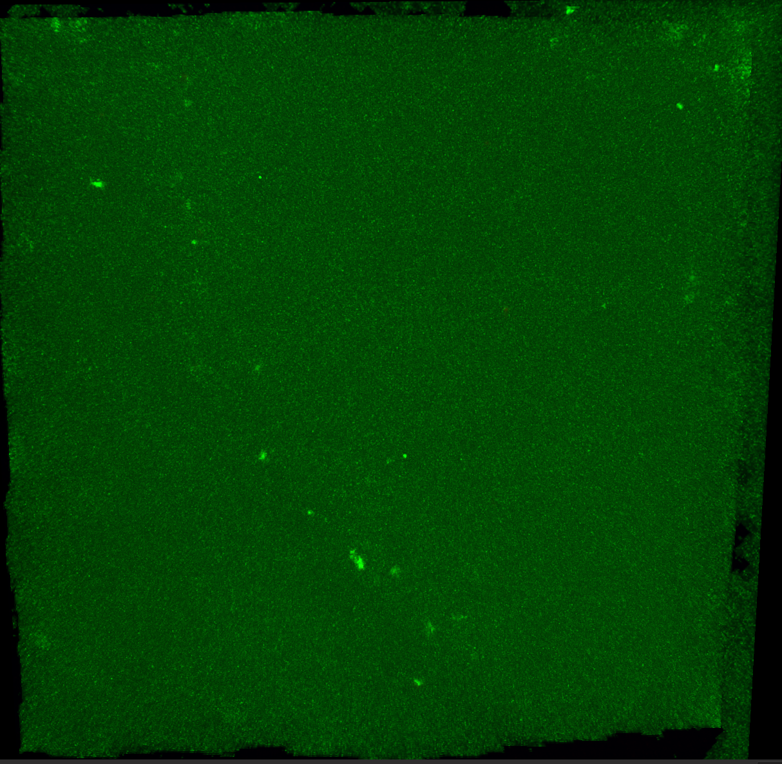
Binary Threshold = 4
Size Threshold = 2000
Before
After
High skin auto fluorescence inhibit visualization of GFP signal
SkinZap removes auto fluorescent skin revealing subsurface signals not visible before (White Triangles)

